Slide 1

Market
Research
Consumer Attitudes
Toward E-Book Reading
Tools of Change, New York, NY - February 15, 2012
Notes:
In this session, Kelly and I will update data from BISG’s Consumer Attitudes Toward E-Book Reading Study. And, for the first time, we’ll introduce data from Bowker’s Global E-Boo Monitor Study. First, a word about Consumer Attitudes:

Slide 2
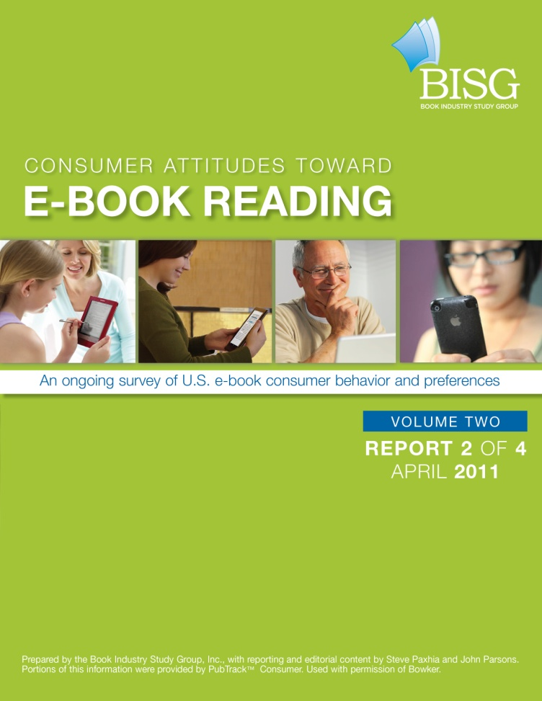
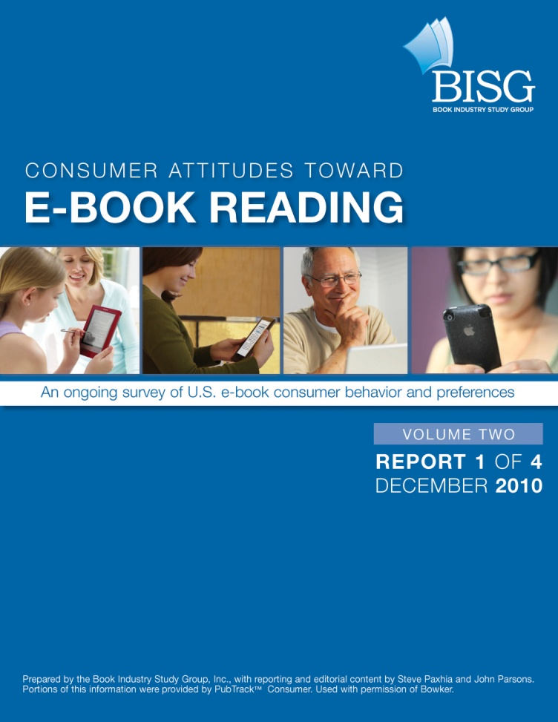
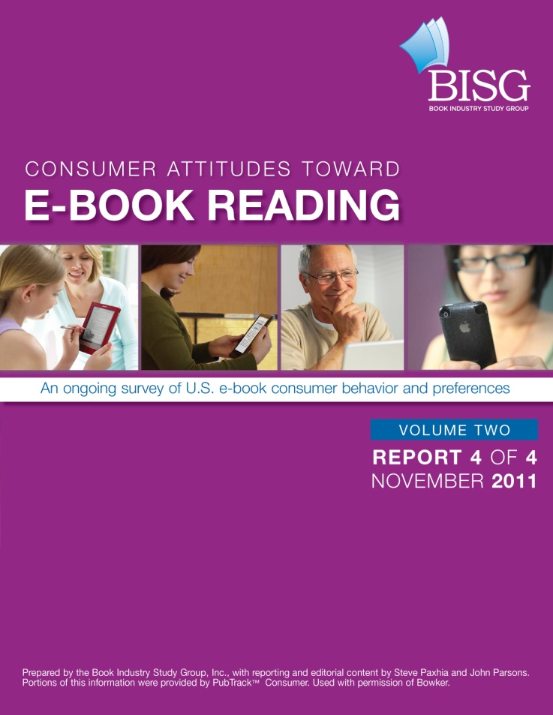
Notes:
What has made this study so successful, and so important to the industry, is the trend data. We’re presenting data – not yet published – from the first fielding of our third volume of the study. We had four fieldings in Volume 2, and three in Volume 1. In other words, we’ve created a solid baseline of data against which we an now measure shifts in how consumers acquire and consumer e-books.
Data for Consumer Attitudes Toward E-Book Reading was derived from a sub­group of a nationally representative panel of more than 72,000 unique U.S. book-buying men, women, and teens representing purchases of more than 180,000 unique book units. The fielding period covered in this report was from December 1, 2011, through December 11, 2011. For this fielding, the margin of error is between plus and minus 3.04% at a 95% confidence interval. In other words, if the same size sample were surveyed 100 times, it would produce the same re­sults 95% of the time.

Slide 3
Rewind
Notes:
At this time last year, we saw the long predicted, massive acceleration of e-books. In the final quarter of 2010, and especially into the start of 2011, e-books took off in earnest.

Slide 4
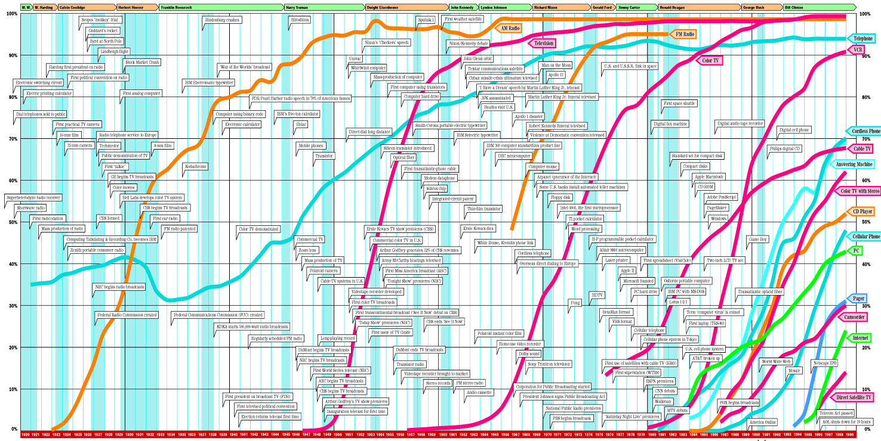
Notes:
This is my all time favorite chart. While you won’t be able to read the text, you’ll get the general idea. This is showing the adoption curve for new technologies from 1910 to 1999. (I’ve never seen an update, but if you have, let me know!) The X axis is time, the Y axis is percent penetration of U.S. households. The squiggly blue line all the way to the left is the telephone. The two red lines in the middle are television and color television. You can see in the case of almost every technology, a slow ramp up, followed by explosive growth leading to almost total penetration. When utility surpasses earlier technologies and when production capacity increases and cost decreases to a sufficient point, the line curves up. So let’s look at last year again for a second.

Slide 5
Notes:
Is this where we are? Is the line curving up? Let’s go to the data.

Slide 6
Notes:
The data shows a slightly different story. To be clear, there was growth. But as 2011 wore on, the curve flattened out.

Slide 7
Really?

Slide 8

Yes, really. But…
Notes:
These numbers are like a bowling average. Some nights you score in the 120s, others in the 220s. Take all the scores together, and it averages out. On which nights are e-books bowling best? Fiction nights.

Slide 9
Fiction is Stranger than Truth
Notes:
What we see is that fiction continued to follow the adoption curve while other categories lagged behind.

Slide 10
Q3 2011Genre Share and E-Book %
Notes:
But, fiction accounts for such a disproportionate amount of dollars, that the impact of e-books is felt much more acutely.

Slide 11
“e” Questions to Answer in 2012
What is the continued growth capacity of Fiction?
When will the other genres get moving?
What roles does technology really play in adoption?

Slide 12

Power Buyer = someone who purchases 4 or more books a month.
Consolidated group of your best
customers who share one
common trait – regardless
of ‘p’ or ‘e’
Notes:
Who are the power e-book buyers, and how do they compare to the buy p-book buyers?

Slide 13
A Book Buyer by any Name… (or Format)
Notes:
We see here that p and e-book buyers look essentially the same. More female than male, 25 – 45 years old, from higher than average income households.

Slide 15
Why?
Notes:
About three quarters – 76% -- of readers have never purchased an e-book. Interestingly, 14% of those readers already own a device of some sort. So why aren’t they reading e-books? What are the barriers to entry?

Slide 16
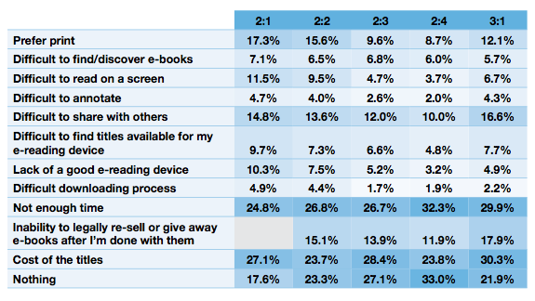
What keeps you from buying e-books?
Notes:
So what are the greatest impediments to e-book purchases. This data is from those who have already acquired at least one e-book in the last 18 months, but it’s telling. There are three very important data points from this latest fielding:
For the first time since we began the study, the number of respondents professing a preference for print, increased. It’s still a small number, but it reverses a steady trend.
There was a marked increase in the two questions that deal with sharing/giving away e-titles. This also reversed a trend that showed steady declines.
Finally, each fielding prior to this fielding, consumers identifying “nothing” as a barrier to buying e-books had increased. For the first time, we saw sharp decrease in this response, from 33% to 22%.

Slide 17



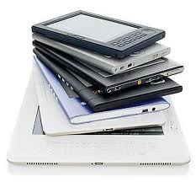


Value of Power Buyers
Print
‘e’
22% of Buyers
35% of Buyers
53% of Books Purchased
60% of eBooks Purchased
50% of $$$ Purchased
48% of $$$ Purchased
Notes:
The e-book power buyer comprises a larger share of the overall e-book universe.

Slide 18
Power Buyers Demonstrate Loyalty
Notes:
As e-book buyers mature in the market, they become increasingly loyal to the format. By the 7 – 12 month mark, more than 70% of respondents are purchasing only or mostly e-books. But note what’s happening once we get to 1+ and 2+ years? The curve flattens and print, oddly, starts to rebound. Why?

Slide 19
“E” at the Expense of “P”
Notes:
Again, you can see that the longer an individual is an e-book reader, the less they spend on other formats. This also peaks in the 7-12 month range, and then oddly, starts to level off, with print making a modest recovery. What’s gong on here?

Slide 20
Scenario Planning
Notes:
While data is helpful in understanding the past, its real value is in helping to understand the future. We call this scenario planning. The trick with scenario planning is not to fall in love with any one scenario, but rather, to examine the data and come to your own conclusion about which scenarios are most likely, and plan accordingly, all the while keeping on eye on developments that might lead to other possible scenarios.

Slide 21
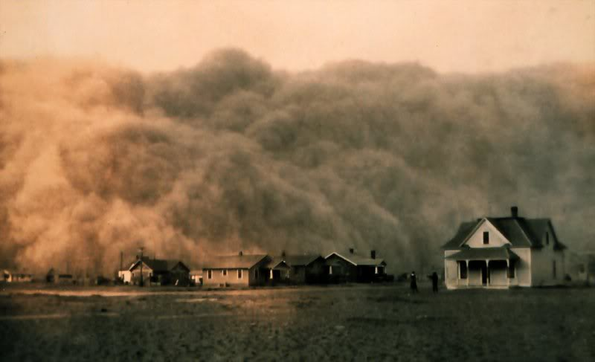
Calm Before the Storm
Notes:
In this case, the data might be suggesting a calm before the storm. We went through a brief period leading up to the administration of this survey in which virtually no new devices hit the market. But we know that the launch of Kindle Fire and the new Nook Color were likely catalysts for e-book growth in Q1 of 2012. So maybe this flattening out is simply a momentary lull before another explosive uptick in digital sales. Let’s revisit our category chart.

Slide 22
Fiction is Stranger than Truth
Notes:
One scenario might suggest that we need to look at the adoption by category, and fiction is simply paving the way for everything else.

Slide 23

Seasonality
Notes:
Or maybe the data is telling us that, at least for now, explosive e-book growth is a seasonal phenomenon. Brick and mortar booksellers are coming off their best holiday season in years. Is that due to the demise of Borders? Or are consumers still largely interested in buying print books as gifts? Will we see the same ebb and flow – or rather, flow and ebb – in 2012 that we saw in 2011, with strong e- and weak p- sales in the first half the year, with the trend settling down in the second half the year?

Slide 24
Notes:
If 2012 follows the pattern of 2011, a scenario in which we settle into a seasonality for e-books could very well be the case.

Slide 25

The Plateau
Notes:
Or are e-books reaching their first real plateau? Is the flattening that we saw in the second half of 2011 exactly that, a flattening? Let’s go back and look at two charts

Slide 26
Power Buyers Demonstrate Loyalty
Notes:
By the time someone has been a power e-book buyer for 2 years, it seems that 1) they do hit a kind of plateau in their e-book purchases, and 2) surprisingly, print starts to creep back up.

Slide 27
“E” at the Expense of “P”
Notes:
This is reflected here is as well. By the time someone has been reading e- for 2 or more years, they seem to find a kind of equilibrium between e- and p-.

Slide 28
Saturated?
According to a Verso Digital study of consumer book buying habits, the number of consumers resistant to purchasing an e-reading device has increased from 40% in December 2009, to 52% in December 2011.
Notes:
Add to that this notion that consumer attitudes toward buying a device are becoming more entrenched, and you can make a case that we’re hitting a plateau.

Slide 29
?
Notes:
The truth is, any of these scenarios are plausible. And if you look closely enough at the data, you can likely concoct additional scenarios. What feels right to you?

Slide 30
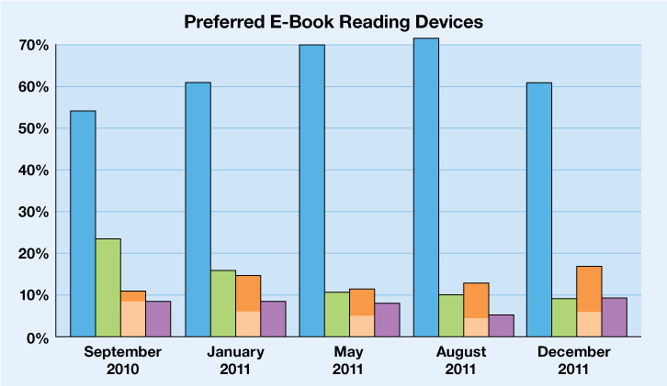
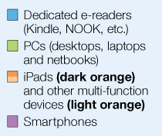
Multi-function Mayhem?
Notes:
These next two slides only add to the confusion. First, we see that respondents have, as you would expect, been steadily decreasing their use of PCs to read e-books in favor of dedicated readers and tablets. But tablets have yet to catch on as devices for reading.
Dedicated e-readers, even though they showed a modest decline in this last fielding, are still the big man on campus. We did see a small uptick in both tablet and smart phone usage in this latest, survey, but that’s to be expected. The number of tablets and smart phones sold dwarfs the number of e-readers sold. Some of those tablet and smart phone owners are bound to use their device for reading. But that number continues to be small.

Slide 31
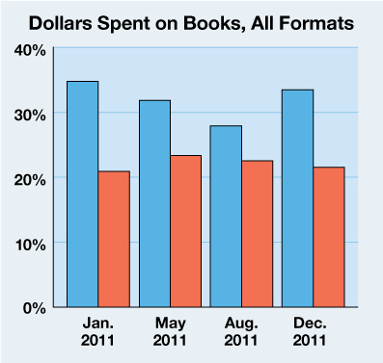
Notes:
Also interesting, our survey respondents, not surprisingly, report an increase in spending on digital formats, and a decrease in spending on print formats. Most encouraging for the book industry is that our respondents report an overall increase in spending on books, regardless of format, compared to those who report a decrease.
But again, look at the trend. There is a clear flattening out here. If anything the gap has been narrowing? What are the causes?

Slide 32

Notes:
We call this the Angry Bird Problem. There are millions and millions of multi-function devices being sold, but reading is not the predominant activity. An Pew survey from October showed that daily activities for tablet users included:
54% get Email
53% consumer News
39% use Social Networks
30% play Games
17% Read Books
The largest problem facing the book industry today isn’t the digital transformation, it’s the increased competition for disposable leisure time.

Slide 33
What about children and youth?
Are they pathways to exponential growth?

Slide 34
Kids 7 – 12 Important Facts:

Slide 35
Teens Triple Rate of E-book Reading

Slide 36
Apple is the Format of Choice

Slide 37


Bold Predictions for 2012?
25%
30%
40%
What’s ultimately best for the industry?

Slide 38

Global e-Book Monitor
Understanding e-book adoption around the world
Bowker Market Research/ToC 2012

Slide 39





Global e-Book Monitor – areas and partners

Slide 40
Methodology
Initial coverage 10 markets where e-book adoption is at different stages
USA, UK, France, Spain, Germany, Australia, Japan, South Korea, India, Brazil
Minimum 1000 respondents in each market
Minimum 250 current/potential downloaders in each market
Fielded January 2012
Standard set of questions about influences and activities:
  Awareness and acquisition of digital content
  Categories downloaded
  Numbers of e-book purchased
  Likelihood of acquiring digital content in the future
  Types likely to be bought
  Factors most likely to encourage e-book purchasing
  Factors most likely to discourage e-book purchasing
  Impact of digital material on book purchasing
  Device access – current and potential

Slide 41
Some early key findings from first wave – Europe only

Slide 42
Awareness of and whether paid to download a complete e-book in past six months

Slide 43
Awareness of and whether downloaded a complete e-book for free in past six months

Slide 44
% of downloaders buying e-books in
each category in last six months

Slide 45
Key findings to be released via partners end March/early April –
Check BISG website for upcoming webinars

Slide 46
Thanks for Listening!
Kelly Gallagher
Vice President, Market Research
Bowker
Kelly.Gallagher@Bowker.com
Len Vlahos
Executive Director
Book Industry Study Group
len@bisg.org

